Slide 1
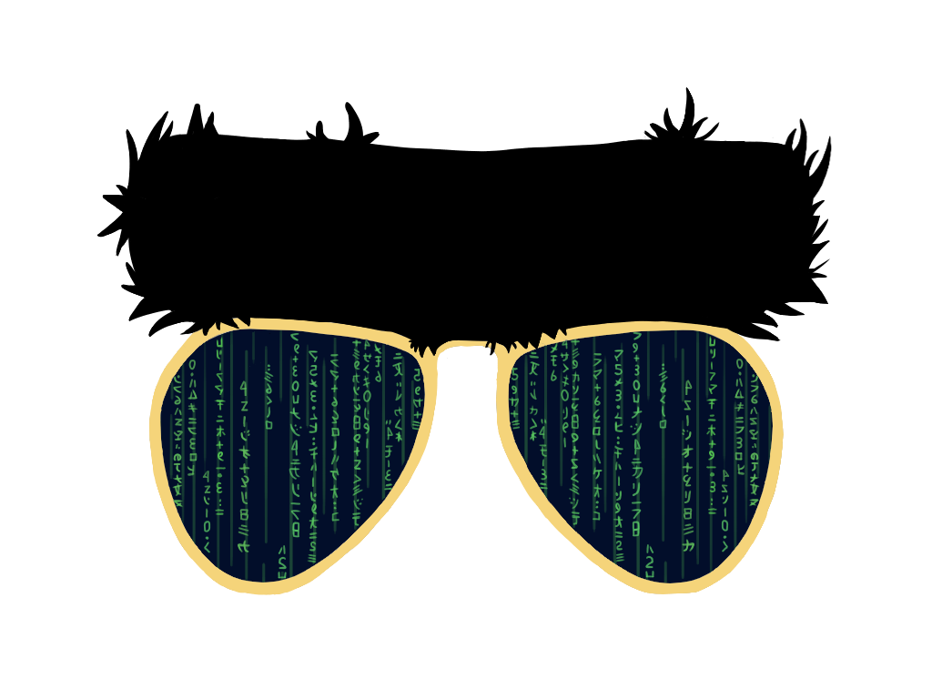
Siduo “Stone” Jiang
William Casey King
Cristopher Benge

Slide 2


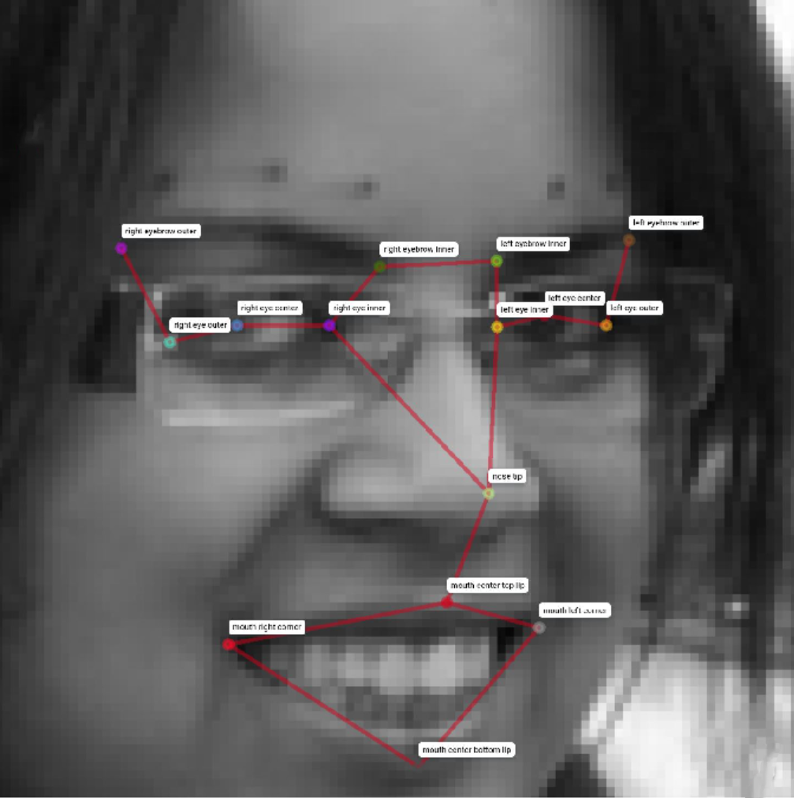

Your Mission, Should You Choose To Accept…
Detection of [up to] 15 facial landmarks on 1,783 images
Unlabeled Image
Keypoints Detected
Dataset
96h x 96w x 1c grayscale images
Pixel values [0..255]
Up to 30 labels of 15 keypoints in (x,y) coordinates for each image.
Images provided as space-separated integer array (1 x 9,216)
Find (x,y) coordinate for…
eye center (left, right)
eye inner corner (left, right)
eye outer corner (left, right)
eyebrow inner corner (left, right)
eyebrow outer corner (left, right)
mouth corner (left, right)
mouth center (top, bottom)
nose tip
train [7,049]
test [1,783]
Performance measured by RMSE:
$$\sqrt{\frac{1}{n}\sum_{i=1}^{n}{{\left(y_{i}−{\hat{y}}_{i}\right)}^{2}}}$$
full [2,140]
partial [4,954]
01
U.C. Berkeley, School of Information – MIDS W207, Spring 2020

Slide 3
Project Lifecycle
04 – Model Experimentation
02 – Naïve Model
Various model architectures are evaluated, compared to baseline, and minor tuning is performed to identify the most suitable strategy.
A naïve model is created to serve as a baseline and to validate that all the plumbing work done from ingest to inference.
01 - EDA
Exploratory data analysis is performed to understand the data and the challenges we’ll have to address to achieve acceptable model performance.
03 – Cleaning & Augmentation
05 – Tuning
Cleaning and augmentation of the training data set is a significant part of any ML project; this one was no exception.
Hyperparameter tuning, regularization, and other optional techniques (such as generalized stacking) are performed to fine-tune for ideal performance.
02
U.C. Berkeley, School of Information – MIDS W207, Spring 2020

Slide 4
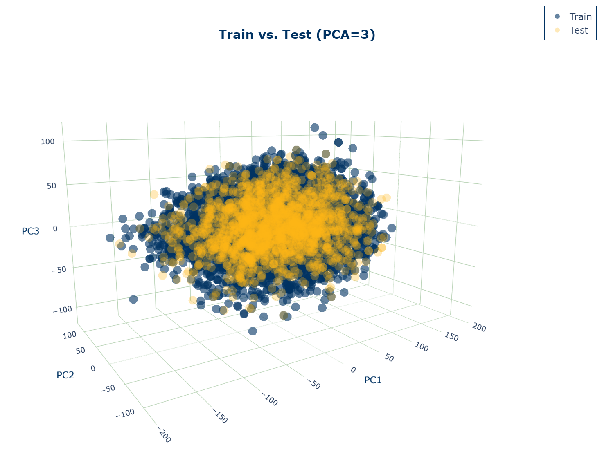
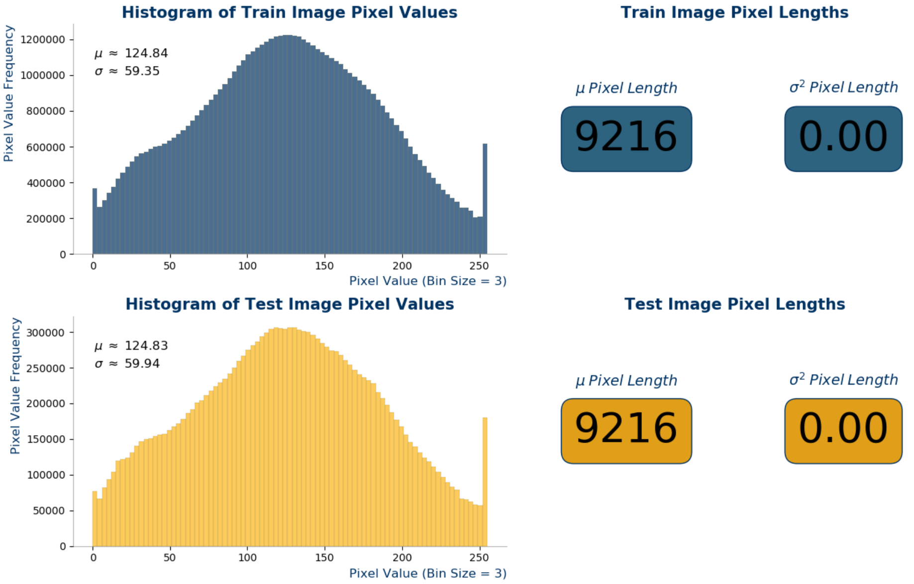
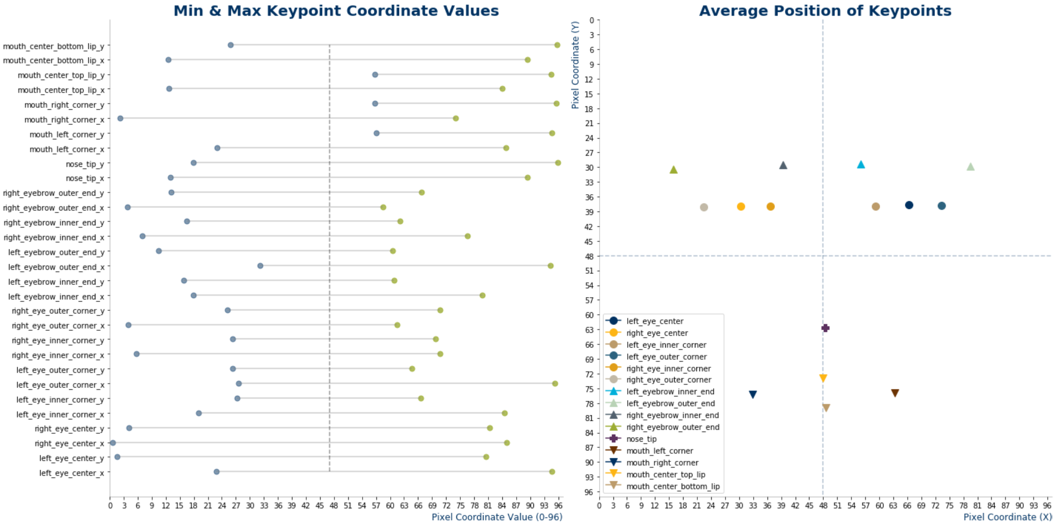
Exploratory Data Analysis
Preliminary assessment of data quality in both train and test datasets
Adversarial Validation
Distribution Analysis
(X, Y) Extreme Position Values
Principal Component Clusters
Principal Component Clusters
Pixel Intensity Distribution
Coordinate Validation
PCA was performed on train and test and compared as a means to quickly assess if their distributions were similar enough to make reasonable predictions from.
PCA was performed on train and test and compared as a means to quickly assess if their distributions were similar enough to make reasonable predictions from.
The distributions of pixel intensity values are nearly identical between train and test. Further, there are no images in either set “missing” pixel values.
Some of the images have extreme locations along the X or Y axis (i.e. a nose tip that appears at the “top” of the image), implying some images are not centered or face-forward. Regardless, the average coordinate positions for each keypoint forms what looks like a centered face.
03
U.C. Berkeley, School of Information – MIDS W207, Spring 2020

Slide 5
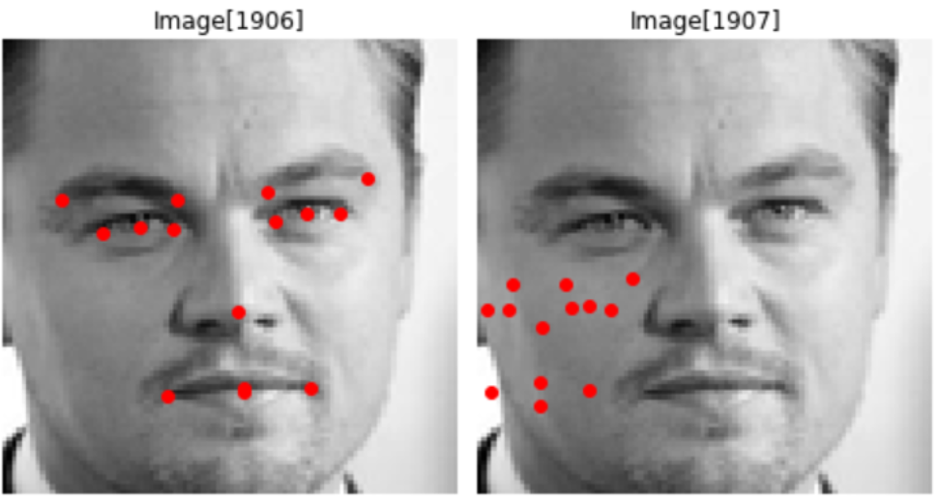
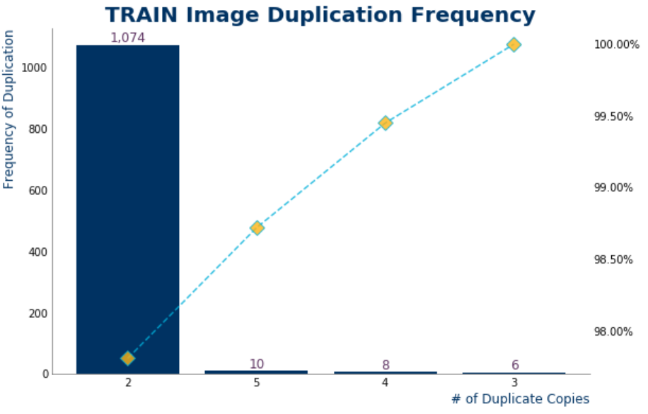
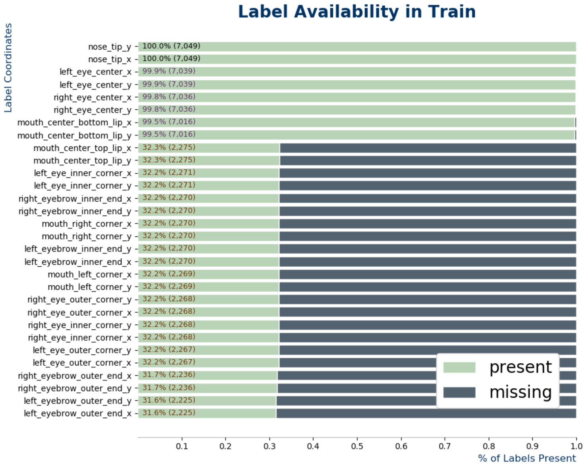
Exploratory Data Analysis (Contd.)
Preliminary assessment of data quality in both train and test datasets
Label Availability
A large number of training images possess only a fraction of the labeled keypoints.
Label Quality
A visual inspection of labels revealed the presence of both duplicate images and incorrect labels. These will need to be addressed to improve the quality of keypoint predictions.
Duplicate Images
There are a large number of duplicate images in train. Reconciling these will be essential to attaining a top score.
04
U.C. Berkeley, School of Information – MIDS W207, Spring 2020

Slide 6
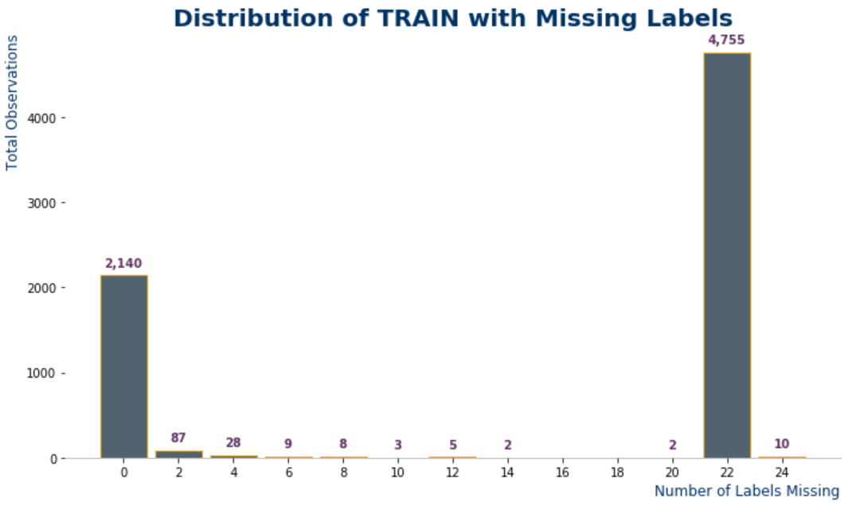
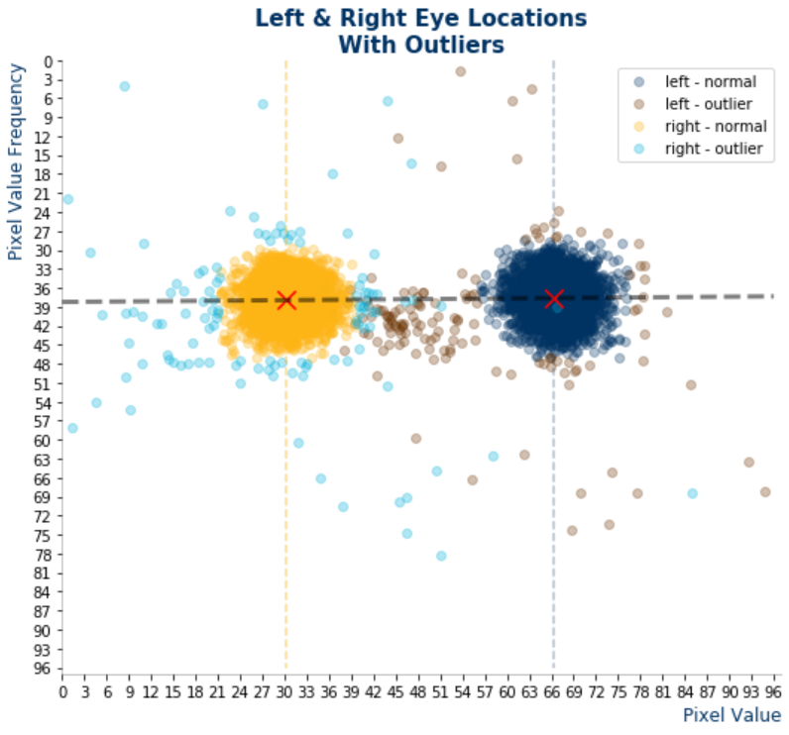
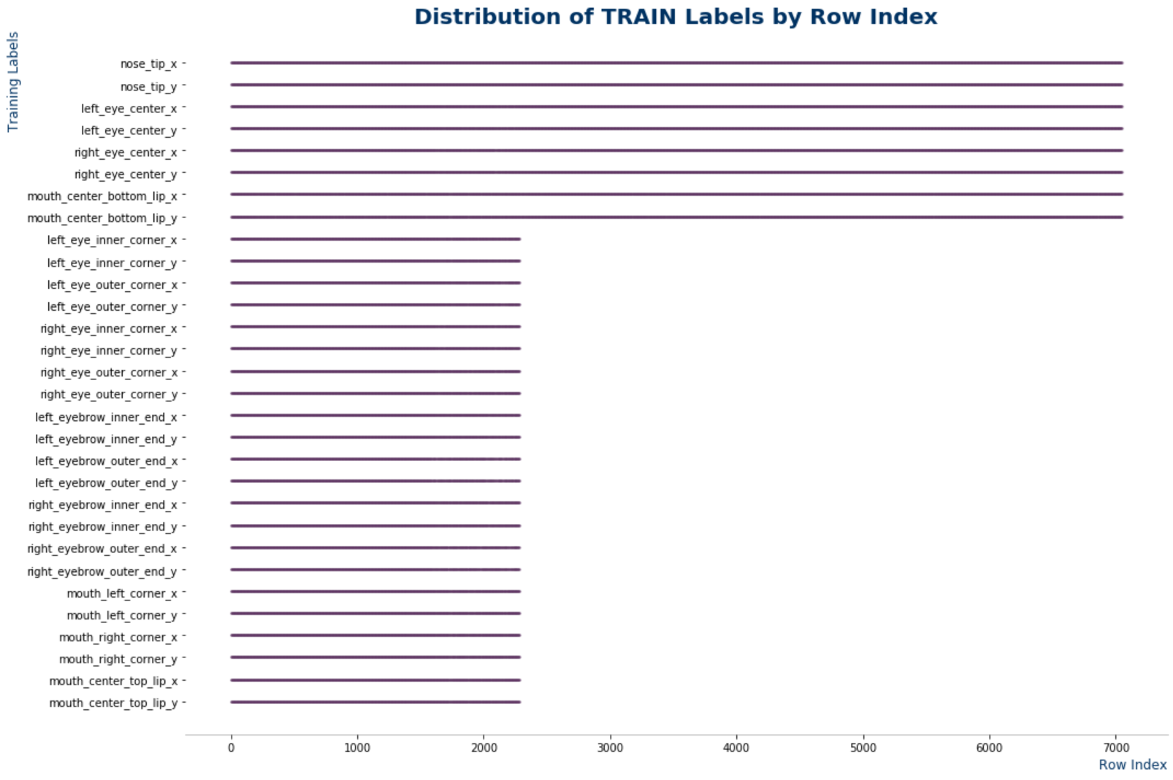
Exploratory Data Analysis (Contd.)
Preliminary assessment of data quality in both train and test datasets
Missing Labels (Contd.)
When ordered by physical row index, a pattern emerges that suggests train originates from two distinct datasets.
Missing Labels Analysis
Eigeneyes
It appears that there are roughly two types of images provided by the organizers: 2,140 have all 15 keypoints, and 4,755 have only 4 keypoints.
Most of the eyes are picture centered, but a handful (those in light blue and maroon) are positioned more than 3σ from μ.
05
U.C. Berkeley, School of Information – MIDS W207, Spring 2020

Slide 7
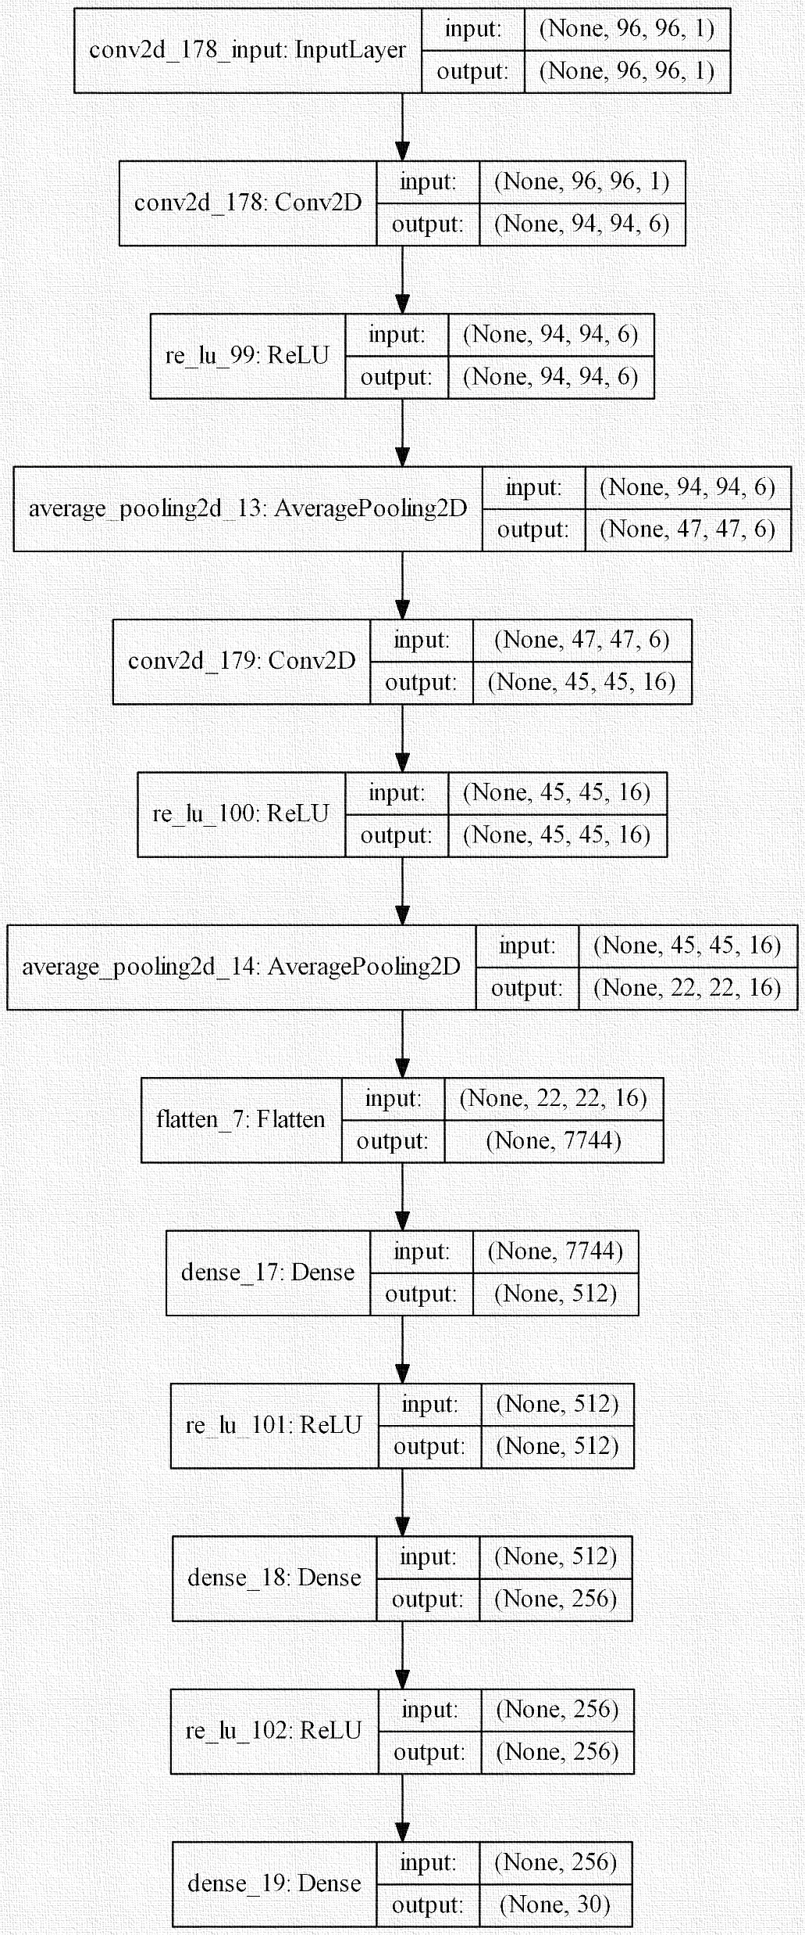
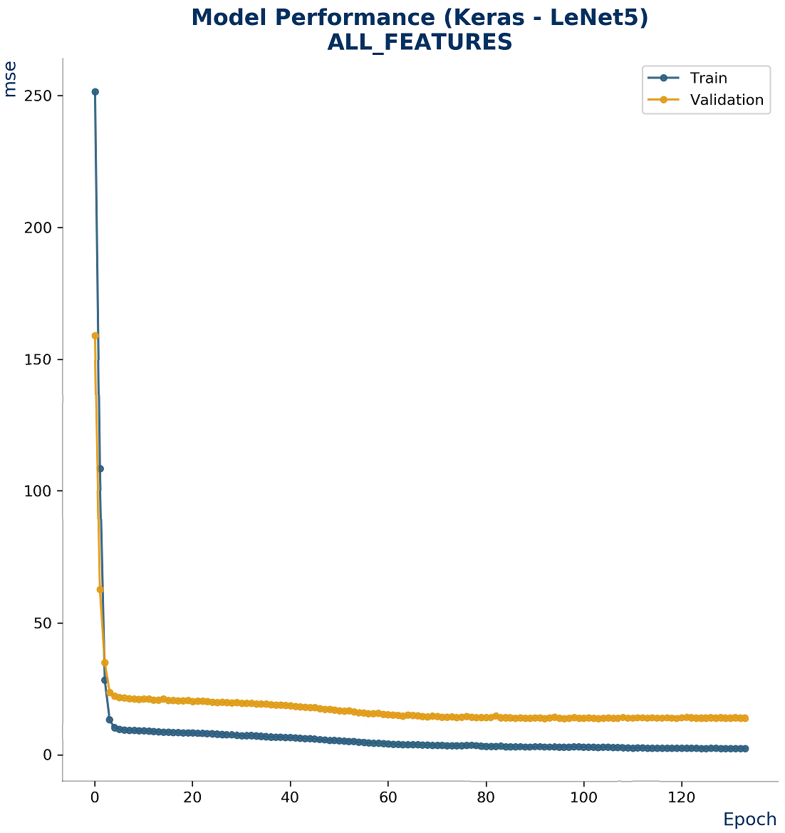
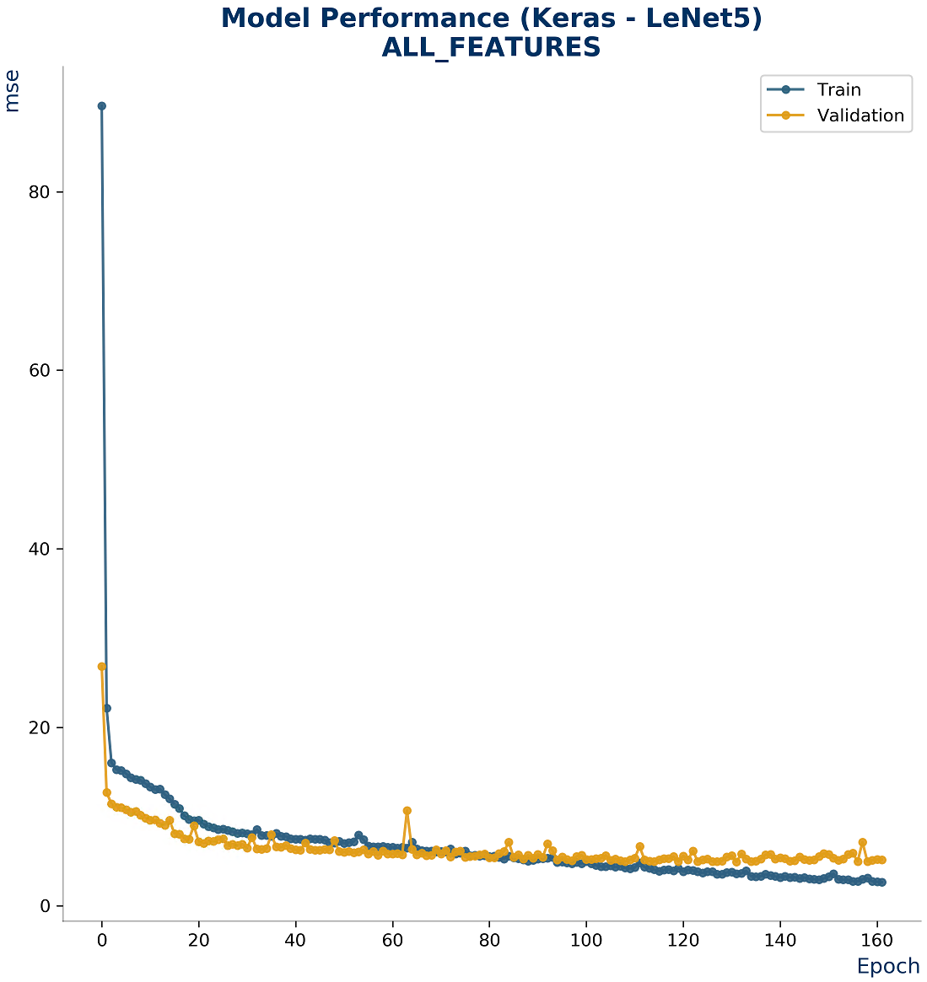
Naïve Model (Baseline)
LeNet-5
The classic 5-layer LeNet-5 (2 x convolution, 3 x dense) was used as the project baseline. No augmentation was used for our baseline, and only image de-duplication, dropping of two low quality images, and manually fixed labels for 55 training images was applied.
All training is fixed at 128 batch size, 300 epochs with patience set at 30. Adam optimization is used with an initial learning rate of 0.001, beta1 of 0.9, beta2 of 0.999, and epsilon of 1e-8.
Training and test was split into two separate tasks : Path #1 learns and predicts all images where all 15 keypoints are present. Path #2 learns and predicts all images where only 4 keypoints are present. At submission time, these predictions are combined.
Under this scheme, and with no added regularization, LeNet-5 scored 2.33068 RMSE on the private leaderboard. This is good for 51st place.
51
06
U.C. Berkeley, School of Information – MIDS W207, Spring 2020

Slide 8

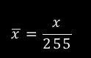
Data Cleaning
Some light cleaning goes a long way…
Drop “Bad” Images
Load “Fixed” Labels
Two train images are removed: [6492,6493]
56 manually selected and fixed train image labels.
x 2
Deduplication
Scale Pixel Values
Hashing to identify duplicate images; taking the mean average of label values.
$$\overline{x}=\frac{x}{255}$$
→ [0..1]
07
U.C. Berkeley, School of Information – MIDS W207, Spring 2020

Slide 9
Data Augmentation Pipeline
The unreasonable effectiveness of data…
Train Data (Raw)
[7,049]
Clean & De-dupe
[6,493]
Dropped
[146]
All 30 labels
8 labels only
18x Augmentation
[2,189]
[4,158]
Train – 8 labels only
Rotation [+/- 5, 9, 13] (x6)
[79,002]
Bright [1.2, 1.5]
Dim [0.6, 0.8]
(x4)
Elastic stretch
(x2)
Contrast stretch (x2)
CLAHE (x1)
Horizontal flip (x1)
Gaussian Noise (x1)
Sharpen (x1)
Train – All labels
[41,591]
08
U.C. Berkeley, School of Information – MIDS W207, Spring 2020

Slide 10
Model Architectures
Models, models… everywhere!
01
LeNet-5
06
ResNet V2 (50)
4.1M parameters (ref)
23.6M parameters (ref)
02
Conv2D 5-Layer
07
Inception V1
3.2M parameters
6.8M parameters (ref)
03
Conv2D 10-Layer
08
Inception V3
7.2M parameters
21.8M parameters (ref)
04
Local2D 5 Layer
09
ResNeXt101
2.4M parameters
241M parameters (ref)
05
ResNet V1 (18, 34)
10
NaimishNet
11.2M / 21.3M parameters (ref)
7.4M parameters (ref)
09
U.C. Berkeley, School of Information – MIDS W207, Spring 2020

Slide 11
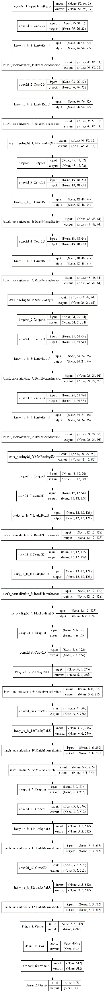

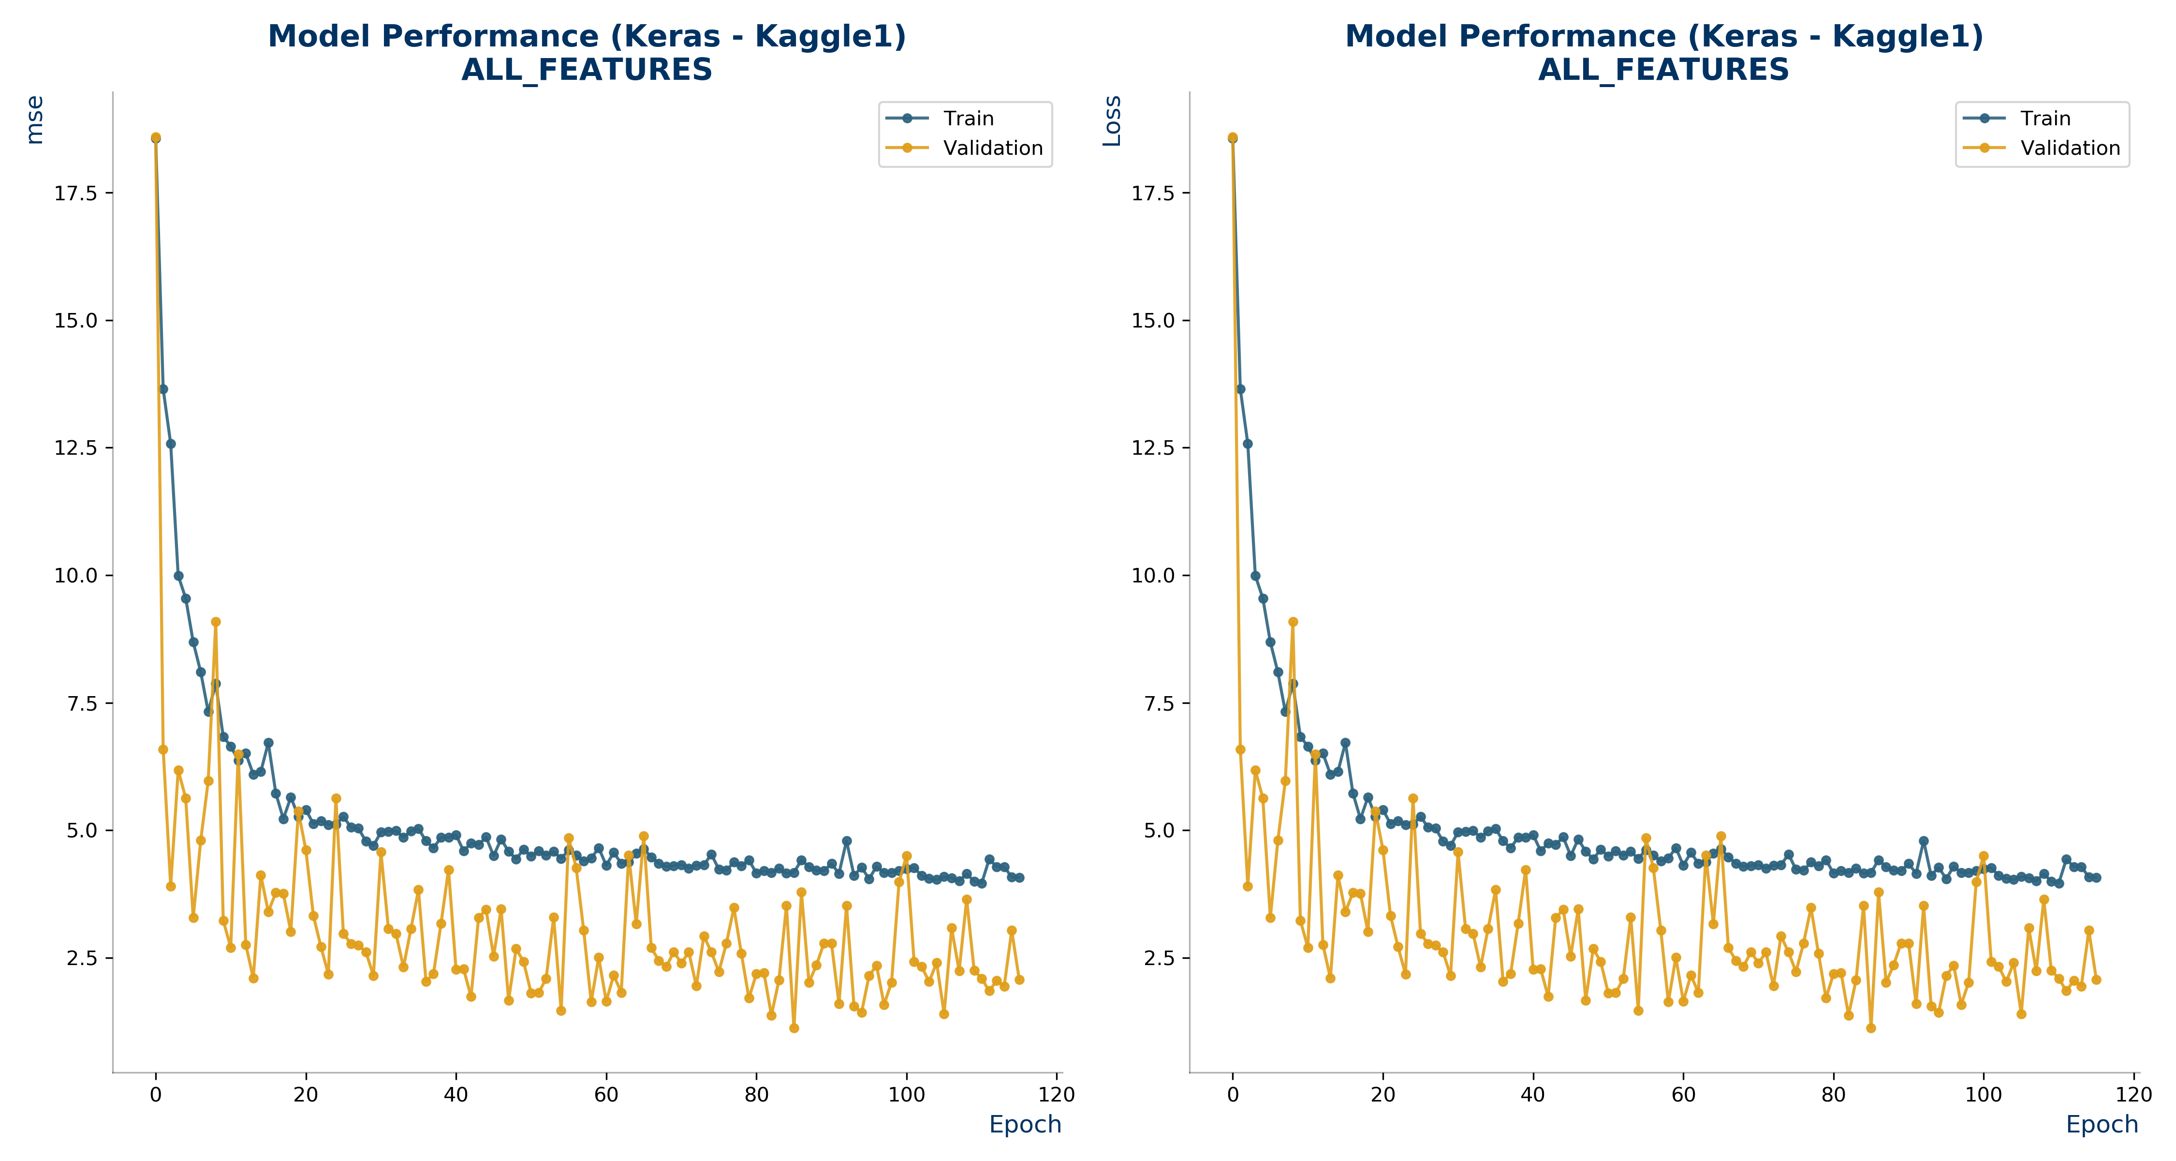
Best Single Model
Conv2D-10 Layer
A best single model in our ensemble was a straight-forward 10-layer CNN that follows a pattern of ever-increasing feature maps (filters) via: conv2d -> LReLU -> batch norm -> conv2d -> LReLU -> batch norm -> max pool -> dropout (X 5). The final layer consist of flatten -> fully connected (512) -> dropout -> fully connected (30 or 8).
All training is fixed at 128 batch size, 300 epochs with patience set at 30. Adam optimization is used with an initial learning rate of 0.001, beta1 of 0.9, beta2 of 0.999, and epsilon of 1e-8.
Conv2D-10 Layer scored 1.35183 RMSE on the private leaderboard. This is good for 2nd place, and is 0.06947 RMSE away from a tie with the 1st place submission.
2
10
U.C. Berkeley, School of Information – MIDS W207, Spring 2020

Slide 12
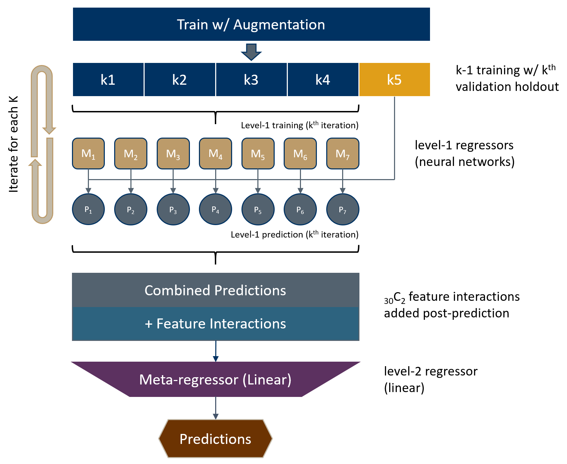
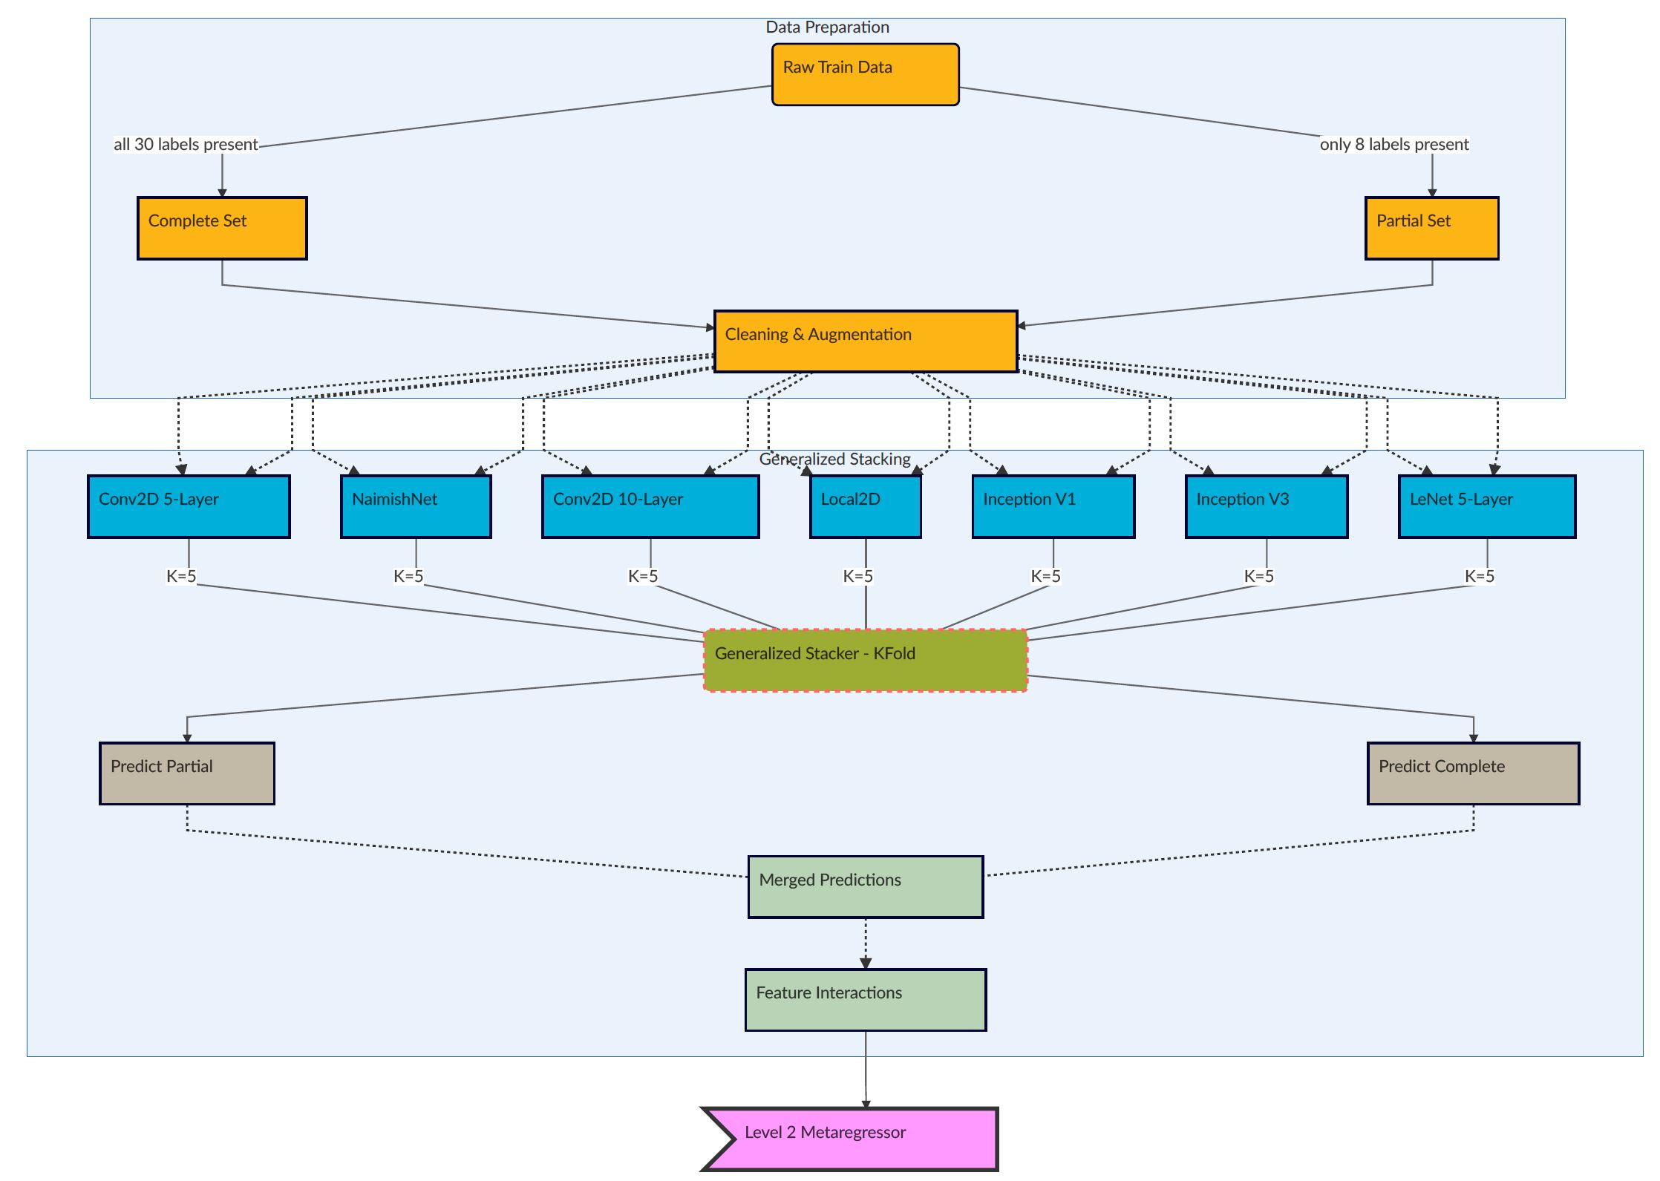
Generalized Stacking
“…a technique whose purpose is to achieve a generalization accuracy (as opposed to learning accuracy) which is as high as possible."
11
U.C. Berkeley, School of Information – MIDS W207, Spring 2020

Slide 13
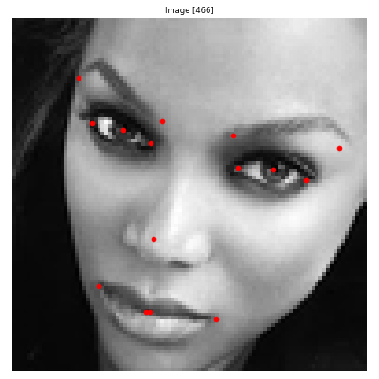
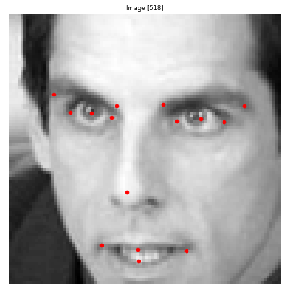
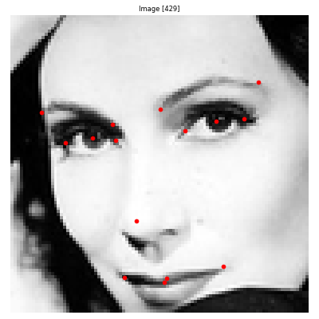
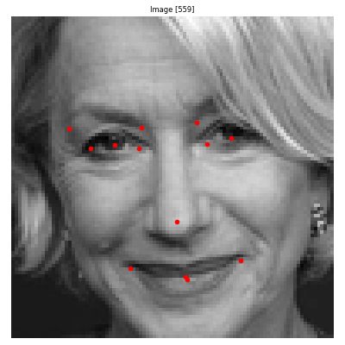
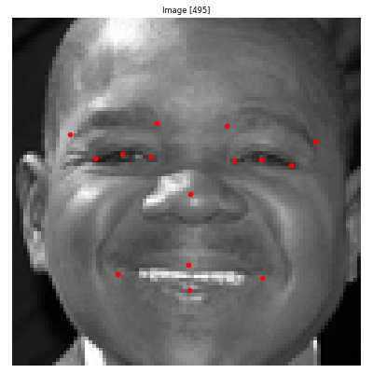
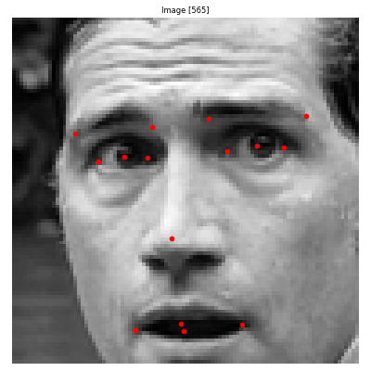
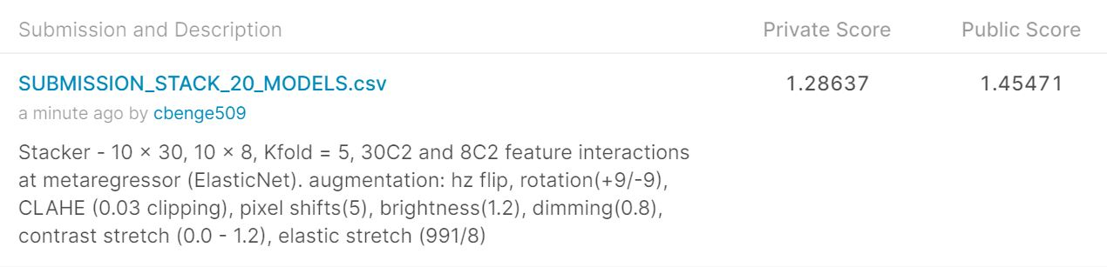
Final Results
Our final submission, consisting of a stacked generalization of 20 models scored a private-leaderboard rating of 1.28637 RMSE or just 0.00401 away for a tie with the 1st place submission.
2
12
U.C. Berkeley, School of Information – MIDS W207, Spring 2020

Slide 14
Key Takeaways
“Science is what we understand well enough to explain to a computer… art is everything else."
01
Cleaning is [almost] everything
With just basic cleaning we got 50th place!
02
The last 10% is 90% of the work
Augmentation, tuning, and stacking – oh my!
03
Don’t allow any assumption to go unchallenged
Sorry, your intuition is [most likely] wrong.
04
Success is non-linear
Be “ok” with failure… a whole lot of failure.
05
When in doubt… put it down
There is a point where progress is best had after a break.
13
U.C. Berkeley, School of Information – MIDS W207, Spring 2020

